Slide 1




BRIGHT WEB CRAFTERS
S C H O O L - P A R E N T A L S Y S T E M
I T C 3 2 7 W
PHASE 2

Slide 2



Introduction
In this presentation, we will take you through the system we’ve developed , explaining its architecture, the UML diagrams, the ERD, and the interface designs that bring everything together.
Our aim is not only to show you how the system works, but also to defend the design decisions we made and why they are the most effective solutions for the problem at hand. Each member of our group will contribute, ensuring balanced participation and a clear, well‑organized delivery.

Slide 3
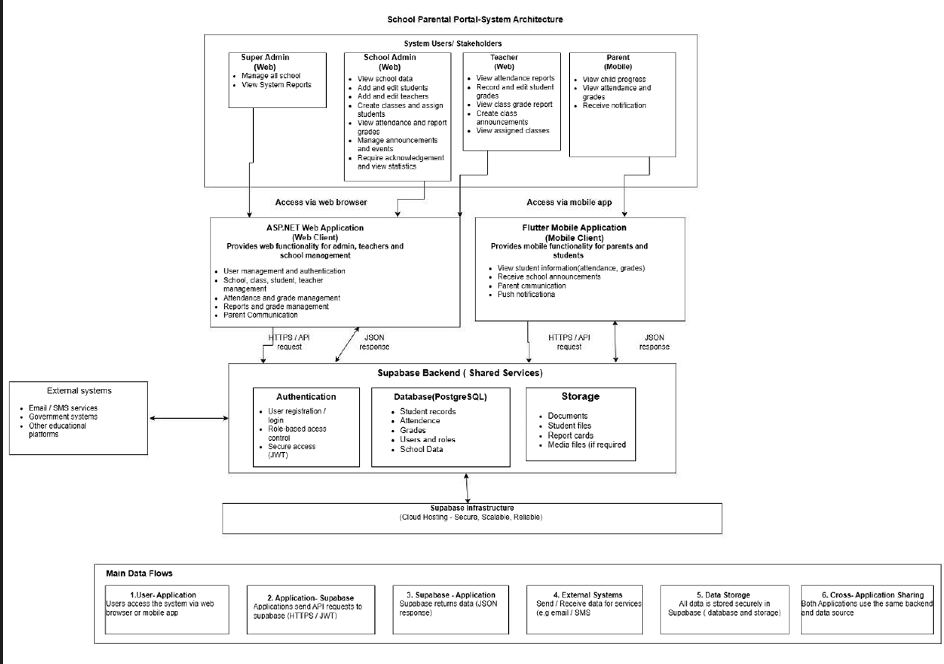
System Architecture

Slide 4
CONT.
Our system architecture consists of four main user groups: Super Admin, School Admin, Teachers, and Parents. Administrators and teachers access the system through an ASP.NET web application, while parents access it through a Flutter mobile application. Both applications communicate with a shared Supabase backend through secure HTTPS API requests. Supabase provides authentication, role-based access, a PostgreSQL database, and storage for documents and student information. This allows all users to access the information relevant to their roles while keeping the data centralized and securely managed.
How the System Works
1. Super Admin uses the web application to manage schools and view system reports.
2. School Admin uses the web application to manage students, teachers, classes, attendance, grades, announcements, and school information.
3. Teachers access the web application to manage attendance, student grades, classes, and announcements.
4. Parents use the Flutter mobile application to view their child's attendance, grades, progress, and receive notifications.

Slide 5
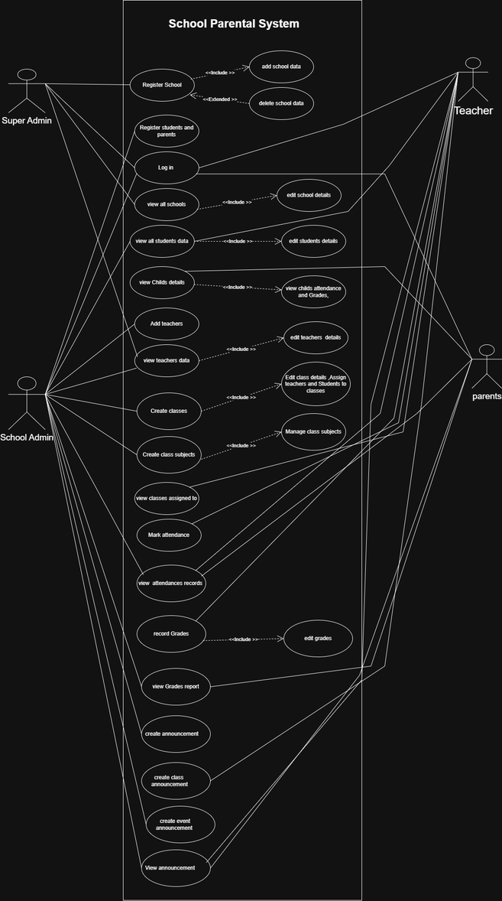
UML Diagrams
Use Case diagram
The School Parental System is built around four main roles: Super Admin, School Admin, Teachers, and Parents.
  The Super Admin sets the foundation by registering schools, managing school data, and overseeing all institutions.
  The School Admin runs daily operations registering students and parents, adding teachers, creating classes, and managing subjects.
  Teachers handle academics: marking attendance, recording and editing grades, and tracking student progress.
  Parents stay informed by logging in to view their child’s details, attendance, and grades.
Communication is supported through announcements whether school-wide, class-specific, or event-related , ensuring everyone stays connected. The include and extend relationships in the diagram show how smaller tasks, like adding data or viewing grades, support larger processes.
Altogether, the diagram illustrates a clear, organized system where each role contributes to transparency, efficiency, and collaboration in school management

Slide 6
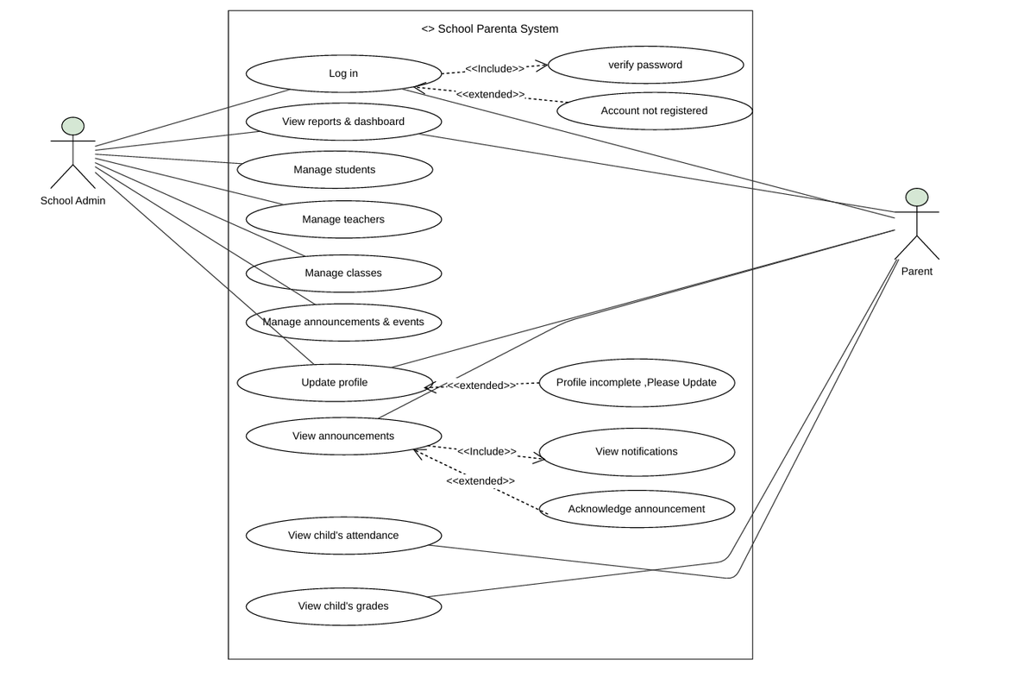
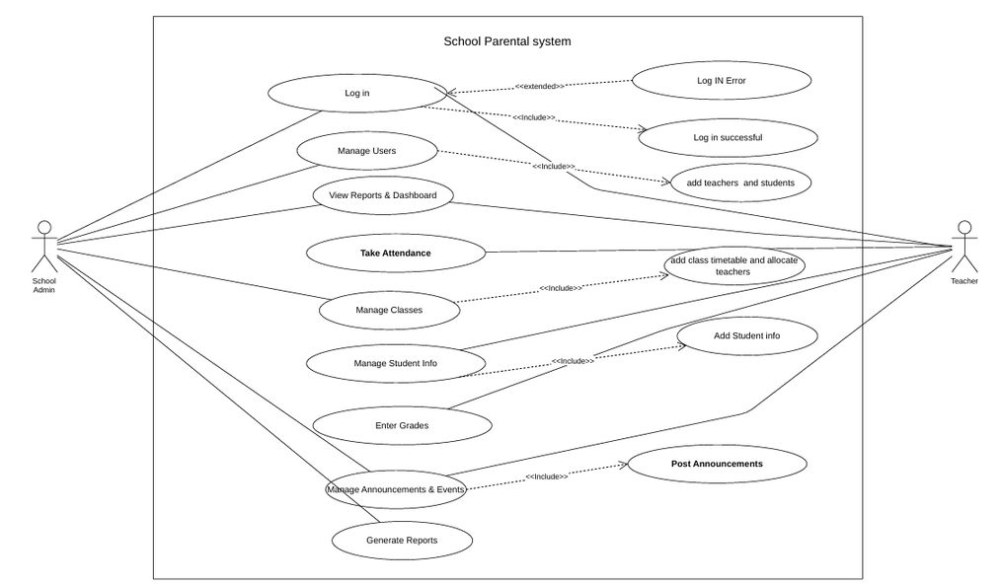
CONT.

Slide 7
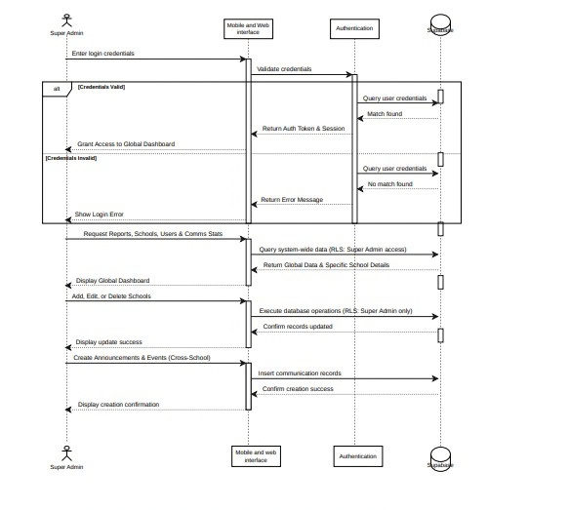
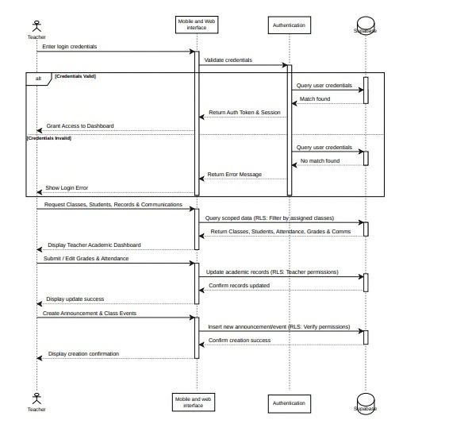
CONT.
Sequence diagram

Slide 8
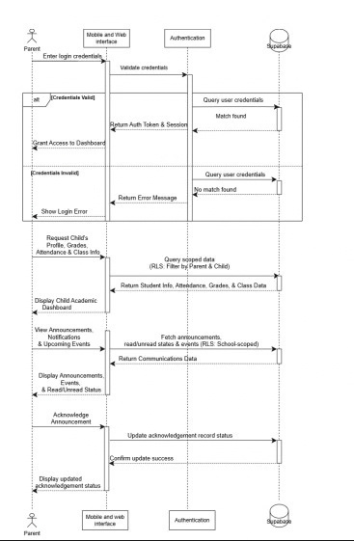
CONT.
The sequence diagram outlines a secure platform where all users first log in to receive a verified authentication token.
Once inside, Parents track their child’s grades and acknowledge school updates, while Teachers access assigned classes to record marks and attendance.
School Admins manage their specific school by adding users and organizing classes, and Super Admins oversee the entire system by managing multiple schools and global analytics.
To keep all this information safe, the database uses Row-Level Security (RLS), a built-in shield that checks the user's token during every request and automatically blocks them from seeing unauthorized data, guaranteeing that parents only see their own child's records and staff only access their assigned information.

Slide 9
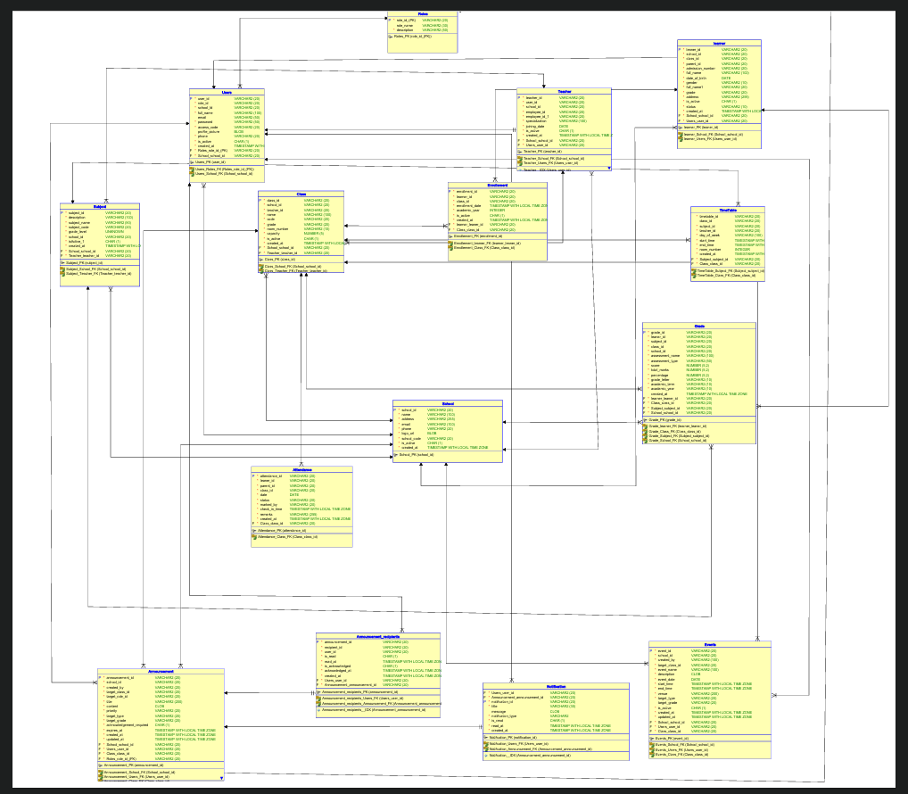
Data Base Design
The main entities are Users, School, Roles, Learner, Parent, Teacher, Class, Subject, Grade, Attendance, Announcement, Announcement_reciplents, Notifications, Events, Timetable, Enrollement . Each entity represents a specific part of the school system. For example, the Learner entity stores learner information, Teacher stores teacher information, Class manages classes, Subject manages subjects, and Grade records academic performance.
Each table has a primary key, such as learner_id or school_id, which uniquely identifies each record. Foreign keys such as school_id, learner_id, and class_id create relationships between the tables and help maintain data integrity.

Slide 10
CONT.
The ERD also follows normalization principles by separating different types of information into different entities. This reduces duplication and makes the database easier to maintain.
For security, passwords should be hashed and not stored as plain text. Some possible improvements are adding a table to clearly connect teachers with subjects and allowing a learner to have multiple parents or guardians.
In conclusion, this ERD provides a structured database for managing the main academic, administrative, attendance, and communication activities of a school.
.

Slide 11
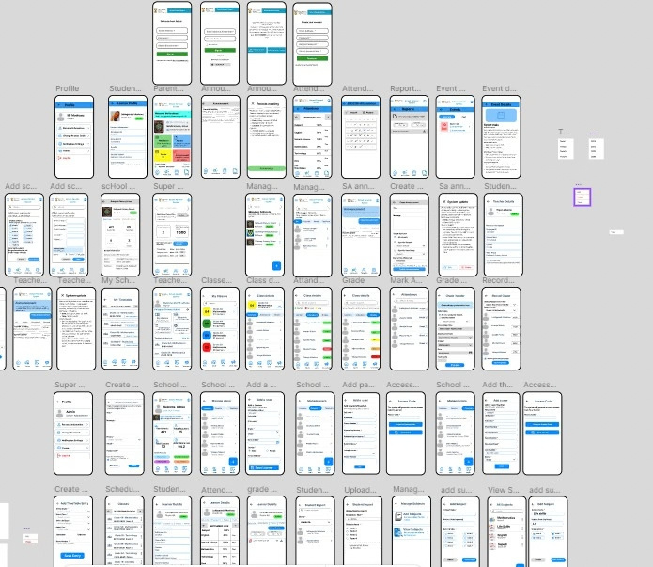
Flutter mobile Interfaces
The School-Parental System is a mobile and web-based platform designed to bridge communication between schools, parents, and educators. As outlined in our SRS, the system serves three primary user roles: parents, teachers, and administrators, each with distinct functionalities tailored to their needs. User Roles and Authentication The SRS specifies role-based access control with three user types. Parents sign in using their South African ID number and a unique access code. Teachers use their work email and an access code. Administrators require an email, password, and an admin secret code for enhanced security. This multi-layered approach ensures sensitive learner information remains protected.
Parent Functionalities Parents access a dashboard displaying their child's profile, including admission number, date of birth, and school details. The SRS outlines key modules: Attendance (per-subject records with calendar view), Reports (downloadable termly PDFs), Events (upcoming activities), and Announcements (school news). Parents can also manage their profile, change access codes, and adjust notification settings.
https://www.figma.com/proto/pG7mL3Oj2Rr37JAT9r7WJv/School-Parental-system?node-id=42-238&p=f&t=0WVSbhhXYOH6dG98-1&scaling=scale-down&content-scaling=fixed&page-id=0%3A1&starting-point-node-id=42%3A238

Slide 12
CONT.
Teacher Functionalities Teachers receive classroom management tools as per the SRS. They can view assigned classes, mark attendance (present, absent, or late), create assessments, record grades, and automatically convert marks to percentages. The timetable feature provides daily schedules with direct links to mark attendance. Teachers can also publish announcements to specific classes with priority levels.
Administrator Functionalities Administrators enjoy school-wide oversight through a dashboard showing total students, teachers, classes, and attendance rates. The SRS details their ability to manage users (add, edit, remove learners, parents, teachers), manage schools, create targeted announcements, upload reports, manage subjects, and add timetable entries.
Key Workflows The SRS defines critical workflows: Admin adds parent → system generates access code → parent signs in. Teacher marks attendance → parent sees update. Teacher records grades → Admin uploads termly report → Parent downloads PDF. These workflows ensure seamless information flow between all parties. Design and Security The SRS emphasises a clean, mobile-first interface with colour-coded statuses (green = present, red = absent, yellow = late) and bottom navigation tailored to each role. Security includes multiple authentication layers, system-generated access codes, and announcement acknowledgement requirements.
Conclusion The School-Parental System provides a comprehensive solution for enhancing communication between schools, parents, and educators. As detailed in our SRS, it offers role-specific functionalities, secure authentication, and intuitive design, fostering collaboration for learner success.

Slide 13
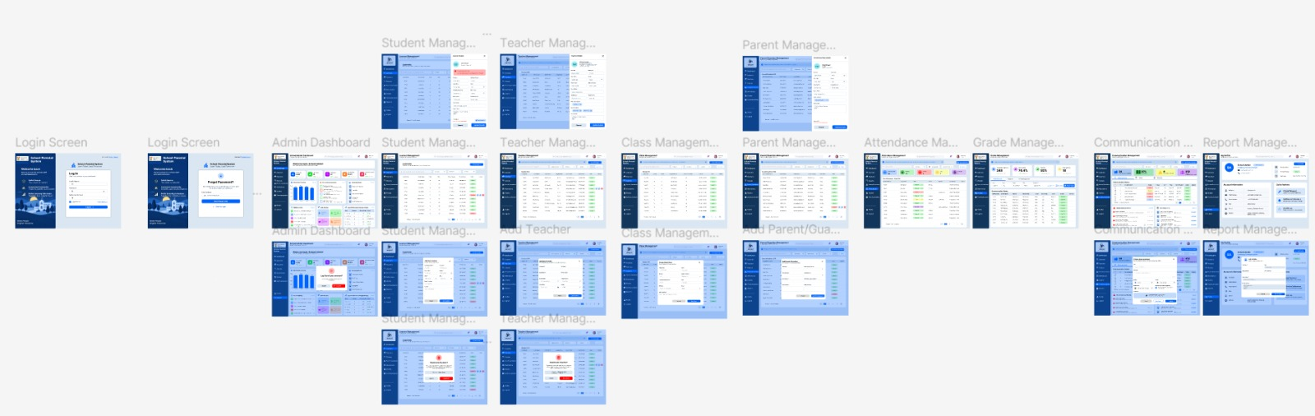
ASP.NET web interfaces
https://www.figma.com/proto/lPObV3qt8TfARP7lGBJZqU/School-Parental-System?node-id=197-2563&p=f&viewport=-167%2C288%2C0.1&t=Gi9OyypmECYmlsAf-1&scaling=contain&content-scaling=fixed&starting-point-node-id=197%3A2563&page-id=0%3A1

Slide 14
CONT.
Web Application Workflow
The School-Parental System web application is divided into three role-based interfaces: School Admin, Teacher, and Super Admin. Each user logs in using their authorised credentials and is redirected to the appropriate dashboard according to their role. Although all three interfaces follow the same overall design, navigation and available functions differ according to the permissions defined for each user.
School Admin Website
The School Admin starts at the Login page and can use Forgot Password if they cannot access their account before returning to the login page. After successful login, the user is directed to the School Admin Dashboard, which provides an overview of the school and navigation to the main modules. In Learner Management, the administrator can add new learners and manage existing learner information. In the prototype, Ethan Brown is used to demonstrate the complete learner workflow. The administrator can view his details using the eye icon, edit his information using the edit icon, or deactivate his record using the bin icon. The Cancel, Update Details, and Deactivate actions return the user to the Learner Management screen. The same interaction is demonstrated in Teacher Management using Michael Kumalo and in Parent/Guardian Management using Xolani Mngadi. The Add Learner, Add Teacher, and Add Parent/Guardian buttons also open their respective forms. In Class Management, the administrator can create a new class using the Create Class button. The Communication Management module allows the administrator to create school announcements, with Cancel returning to the communication screen and Publish completing the announcement process. The administrator can also access their profile and edit profile information. When Logout is selected, a confirmation modal appears; confirming logout returns the user to the Login page, while cancelling returns the user to the dashboard.
Teacher Website
The Teacher website follows the same login, profile, navigation, and logout flow, but the available functions are limited to the teacher's responsibilities. After logging in, the teacher can access their dashboard and assigned class information. Teachers can record and update attendance, view attendance records, and manage learner grades for the classes and subjects they teach. Within Grade Recording, teachers can add new grade records as well as edit existing records. They can also use Communication Management to create announcements for their assigned classes where permitted and view class-related communication and events. This ensures that functions such as attendance and grade capturing remain the responsibility of teachers rather than School Administrators.

Slide 15
CONT.
Super Admin Website
The Super Admin website provides system-wide management across all registered schools. After logging in, the Super Admin can access an overview of the entire School-Parental System and select schools to view their information. The main management function is Schools Management, where the Super Admin can add a new school, view school information, edit existing school details, and deactivate a school when necessary. This follows a similar interaction pattern to the learner, teacher, and parent management screens used by the School Admin. The Super Admin can also view users and reports across schools. In Communication Management, the Super Admin creates system-level communication such as scheduled maintenance notices, platform updates, security notices, tutorial guides, training sessions, and system rollout events. These communications may be directed to all schools, selected schools, School Administrators, teachers, or other permitted system users.
Overall Workflow
Together, the three web interfaces operate as one role-based system. The School Admin manages school information and users, the Teacher manages academic activities such as attendance and grades, and the Super Admin manages schools and system-wide functions. Each interface only exposes the functions required by that role, helping to keep the system organised, secure, and easier for users to understand.

Slide 16

QUESTIONS

